Slide 1
GeoData WS2023-2024<groupH>
<Kwame Agard>, <24171>

Slide 2
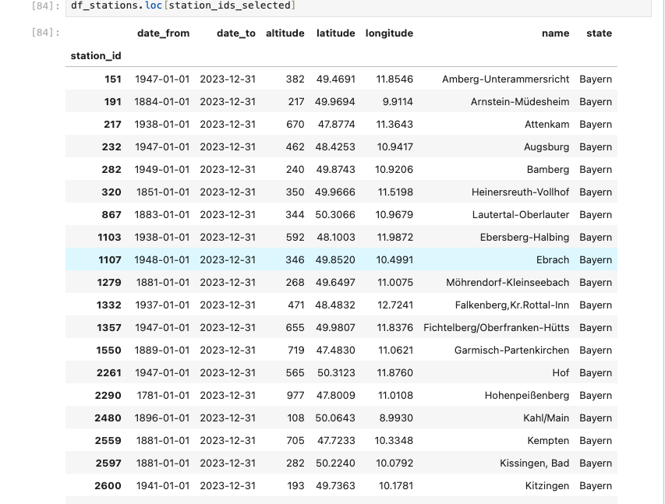
1. Warming Stripes: subtask 1.1
Figure 1.1: shows the 38 stations that operated before 1950 and are still active in Bavaria.

Slide 3
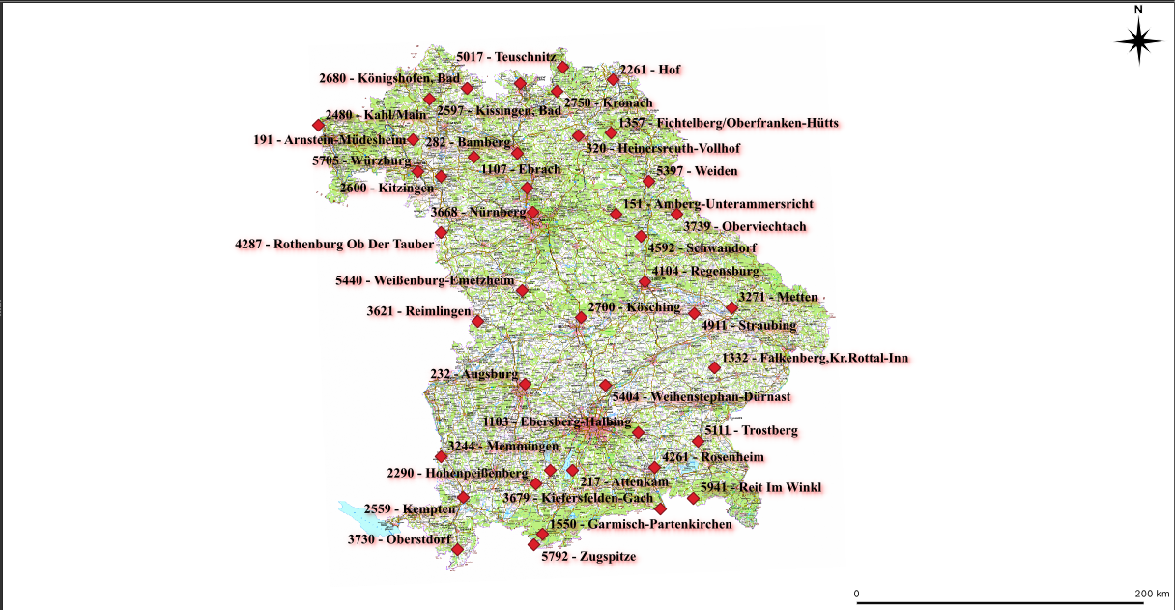
1. Warming Stripes: subtask 1.2
Figure 1.2: Map of Bavaria depicting the location of the stations in the region

Slide 4
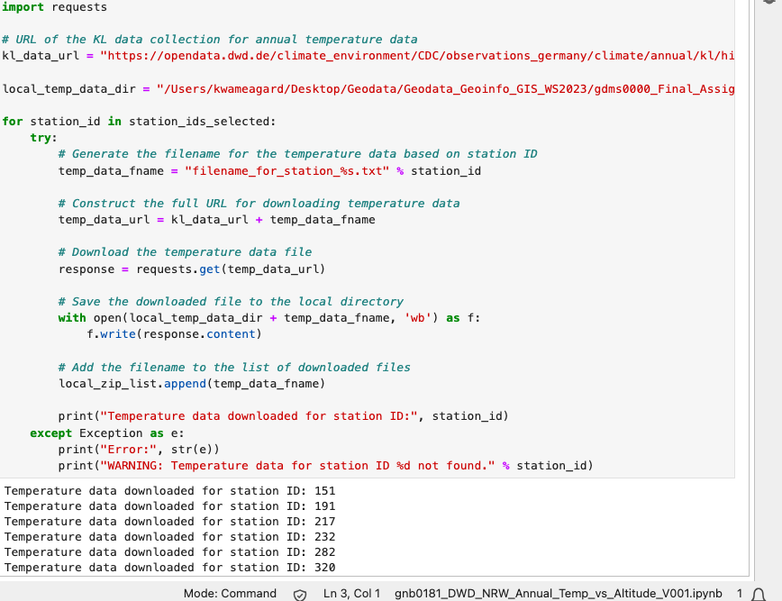
1. Warming Stripes: subtask 1.3
Figure 1.3: this shows the code used to automatically download the annual temperature data

Slide 5
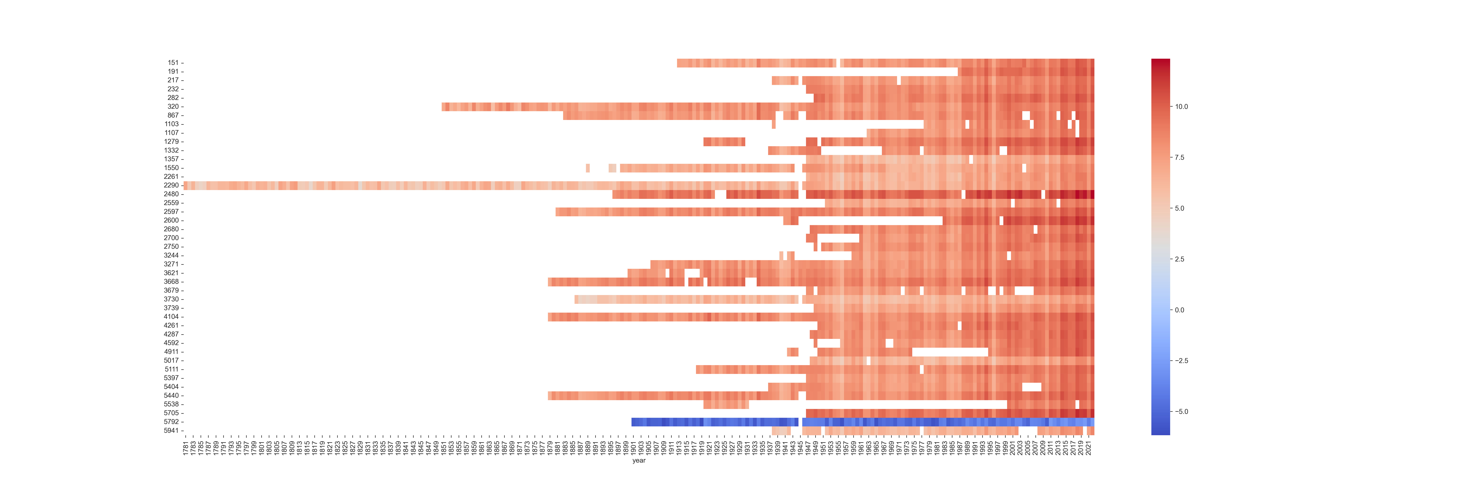
1. Warming Stripes: subtask 1.4
Fig 1.4: Warming stripes plot for the merged temperature time series.

Slide 6
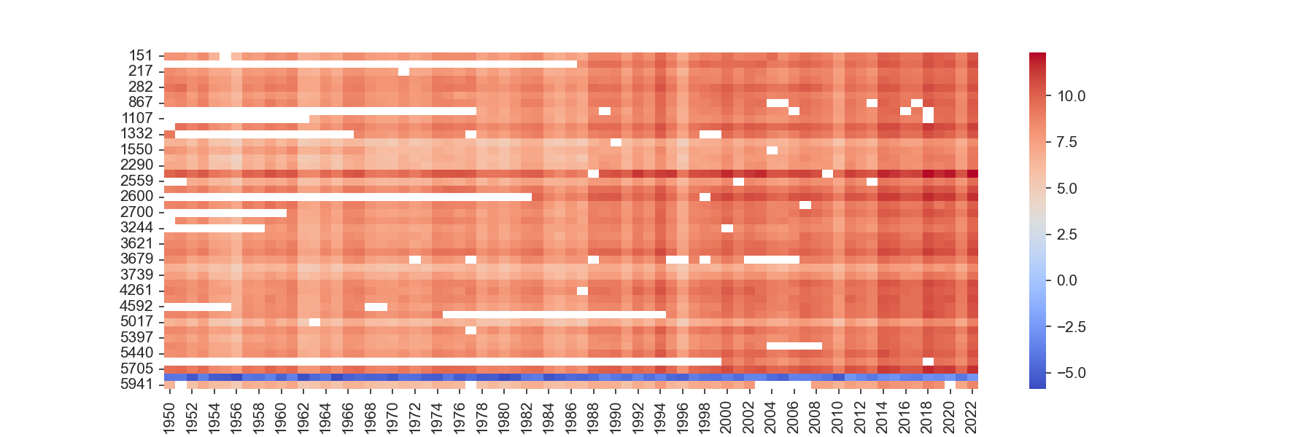
1. Warming Stripes: subtask 1.4
Fig 1.5: Warming stripes plot for the selected stations, from 1950 - 2022.

Slide 7
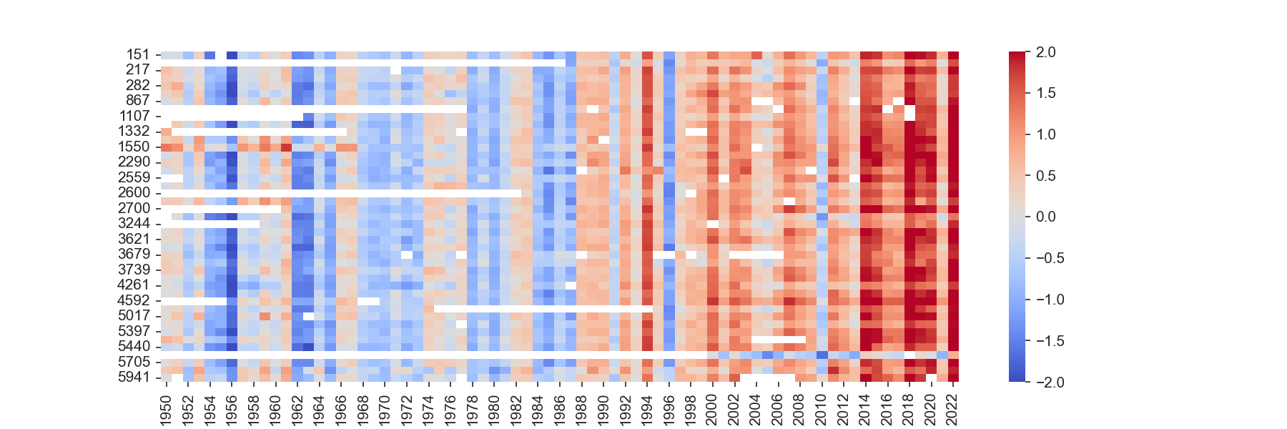
1. Warming Stripes: subtask 1.4
Fig 1.6: Temperature differential warming stripes

Slide 8
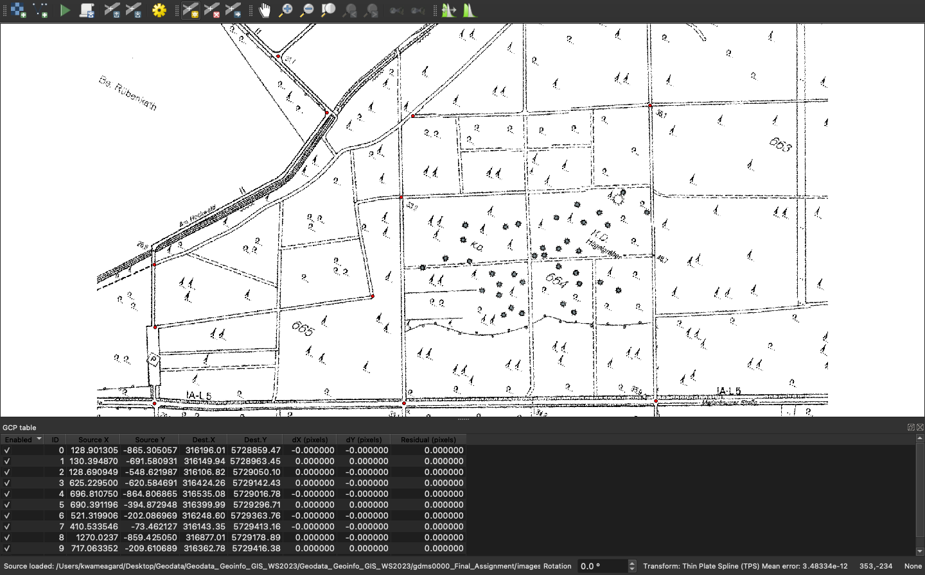
2. Digitization: Burial Mounds in Uedemer Hochwald: task 1.1
Figure 2.1: Using the georeferencer tool to layer a photo of burial mounds on the map

Slide 9
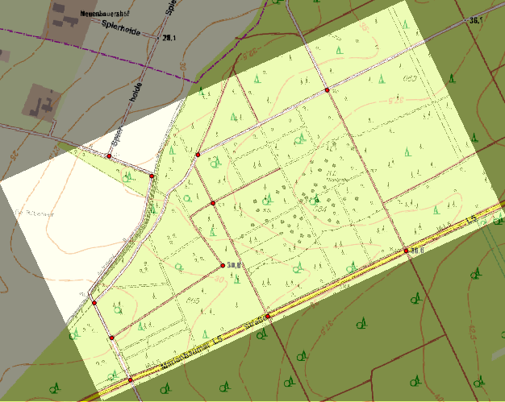
2. Digitization: Burial Mounds in Uedemer Hochwald
Figure 2.2: Final layout of georefrenced map + points of reference

Slide 10
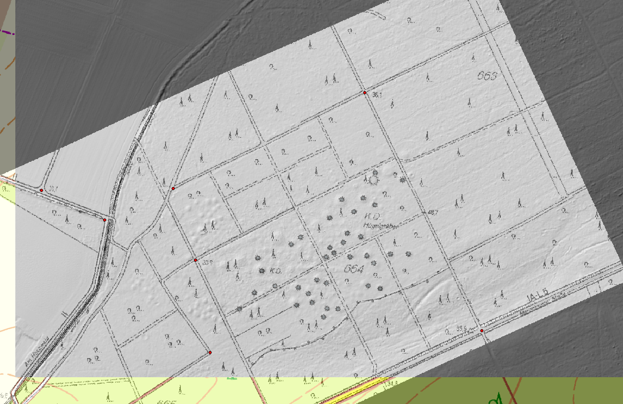
2. Digitization: Burial Mounds in Uedemer Hochwald
Figure 2.3: Georeferenced photo in comparison with hillshade map

Slide 11
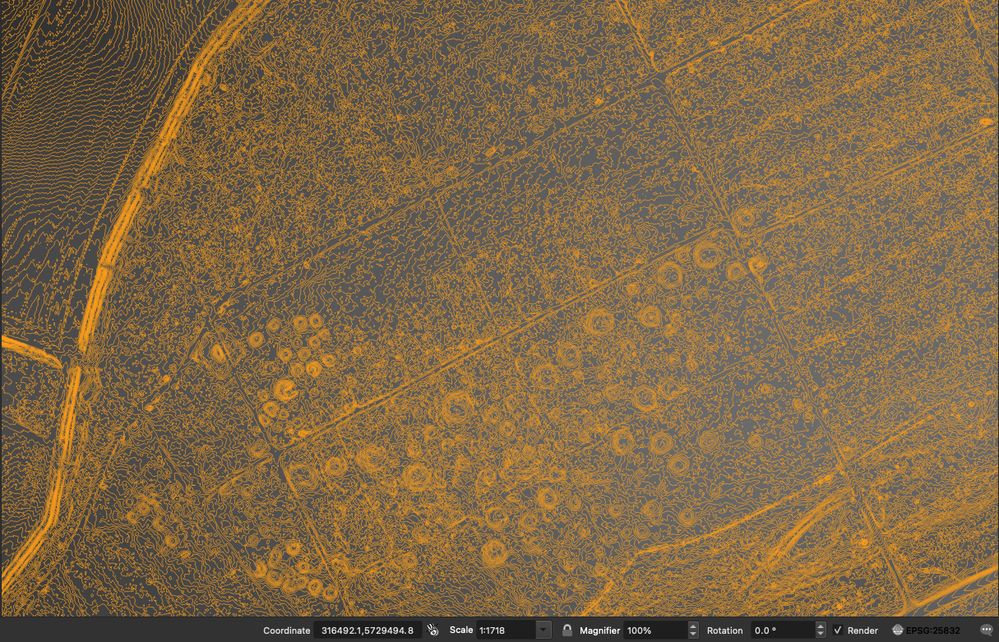
2. Digitization: Burial Mounds in Uedemer Hochwald
Fig 2.4: Detection of Burial Mounds using Contour Analysis

Slide 12
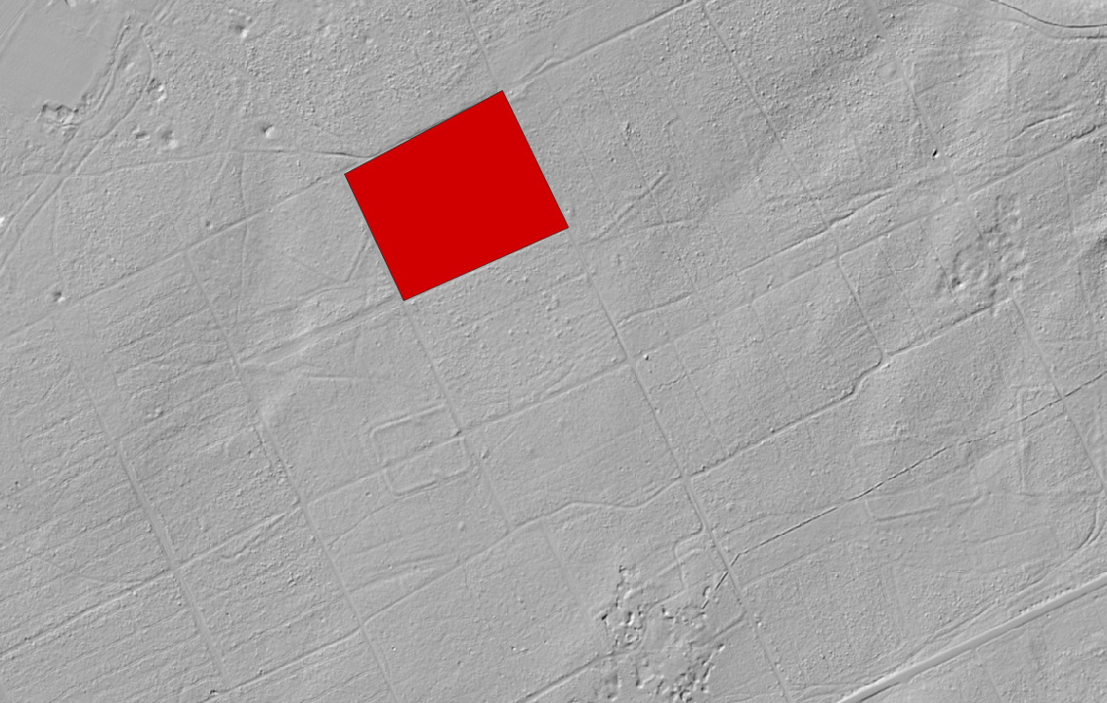
2. Digitization: Burial Mounds in Uedemer Hochwald
Figure 2.5: Rectangular structure North-East of the burial mounds (highlighted in red)

Slide 13
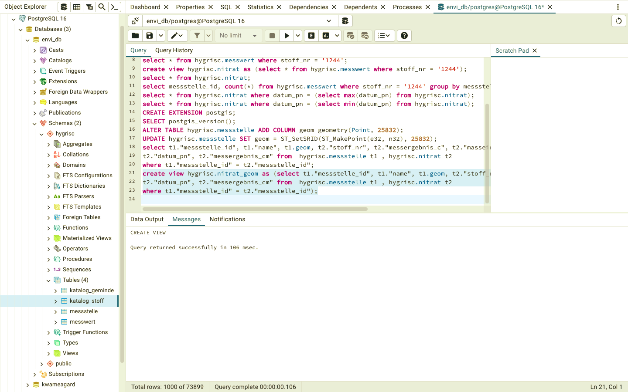
3. OpenHygrisC Nitrate Data: Create a Movie with the QGIS Temporal Controller Connected to PostgreSQL / PostGIS
Fig 2.6: Database Analysis in PostgreSQL: Utilizing SQL Commands for Data Exploration

Slide 14
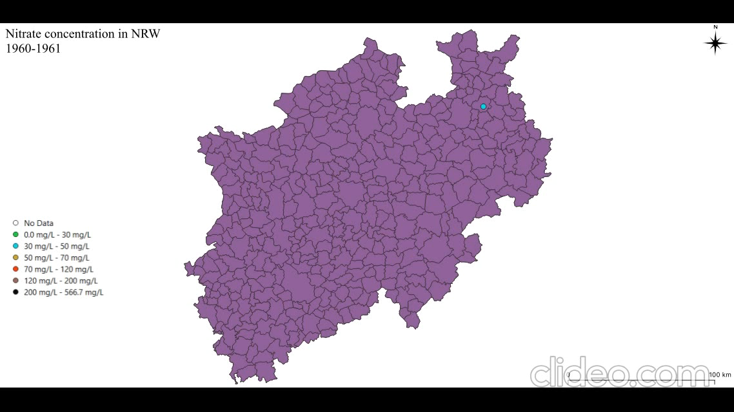
3. OpenHygrisC Nitrate Data: Create a Movie with the QGIS Temporal Controller Connected to PostgreSQL / PostGIS
Fig 3.1: Animation showing of Nitrate groundwater Concentration in NRW: 1960s to 2023

Slide 15
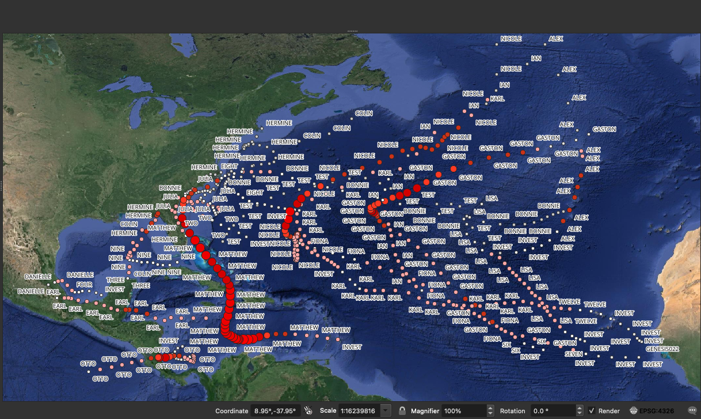
Task 4: Hurricane Tracking in the Caribbean
Fig 4.1: Shows the paths of all storms & hurricanes during the 2016 Atlantic Hurricane Season

Slide 16
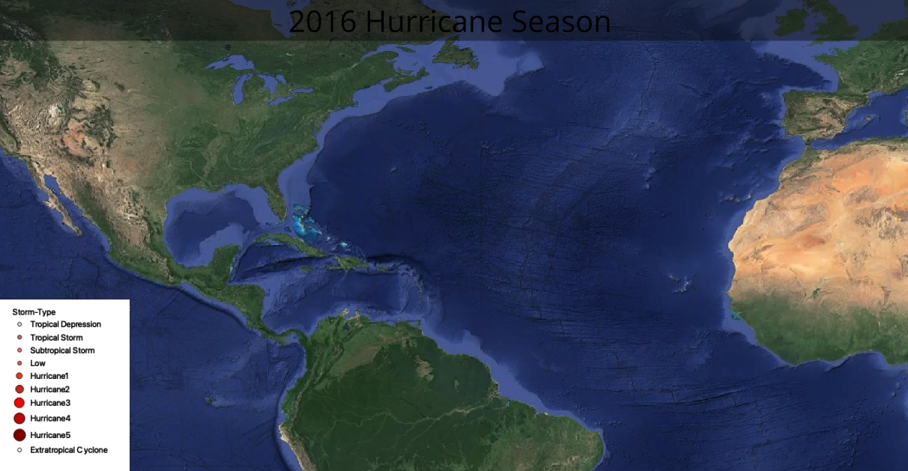
Task 4: Hurricane Tracking in the Caribbean
Fig 4.2: Animation depicting Spatio-Temporal Insights: Tracking Hurricanes in the 2016 Atlantic Hurricane Season

Slide 17
<matno>: Your Personal View
The biggest challenge faced during Task 3 was related to the absence of the geometry data type in PostgreSQL. This issue hindered the process of creating efficient spatial queries and visualizations. To overcome this obstacle, the PostGIS extension was installed onto the PostgreSQL server. This extension provides support for geographic objects, allowing for the storage and manipulation of spatial data within the database.
Lessons learned?:
- Task 1 lessons learned; data manipulation, spatial data processing with geopandas and data visualization with seaborn.
-Task 2 lessons: Georeferencing Techniques, Interpretation of Terrain Features and Remote sensing and feature identification
- Task 3 lessons: Database setup and optimization and Geospatial Data visualization

Slide 18
<24171>: Self-Assessment, Part 1 (give short answers)
What is your role in the group?
<one person team>
Which (sub)tasks are you responsible for?
<All>
With whom have you been cooperating?
<……..>

Slide 19
<24171>: Self-Assessment, Part 2 (On a scale from 1 (poor) to 5 (very good))
What is your personal knowledge gain?
[5]
How do you rate your commitment?
[5]
How difficult is your task?
[2]- being on a team by myself was very challenging

